Slide 1


Slide 2

PRESENTATION SKILLS – 1 ELEVATOR TEST, BLUE SKY THINKING

Slide 3
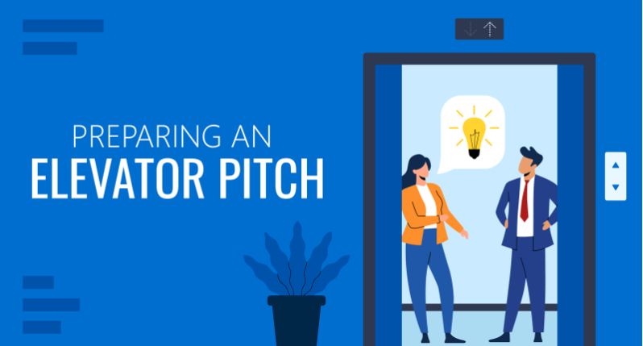

Slide 4
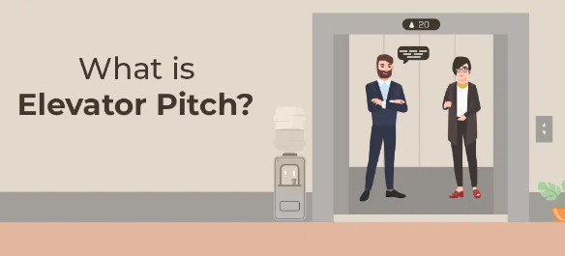
The ELEVATOR TEST is a metaphorical concept used to assess the ability to convey a complex idea or message in a concise and compelling manner. It's based on the idea that you should be able to explain your concept to someone in the time it takes to ride an elevator.

Slide 5
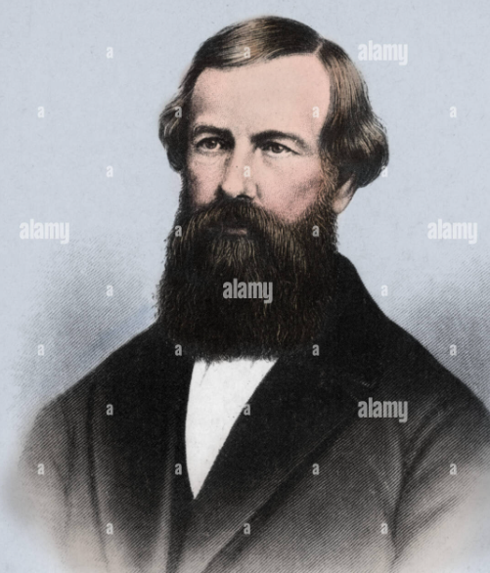
Legend has it that it was elevator pioneer and a famous American Industrialist who created major safety standards for the Elevators ‘ELISHA OTIS’ himself that gave the first true “ELEVATOR PITCH.”

Slide 6
HISTORY AND PSYCHOLOGY:
Roots in sales and marketing: The concept likely originated in the business world, where salespeople often had limited time to pitch their products or ideas to potential clients.
Cognitive psychology: The test aligns with principles of cognitive psychology, particularly the idea of chunking information.
Chunking involves grouping information into smaller, more manageable units to improve memory and understanding.

Slide 7

SHORT AND SWEET: THE PERFECT ELEVATOR PITCH LENGTH
One of the biggest unknowns about creating sample elevator pitches is how long they should be.
In most cases, it will depend on what it’s about and who you’re pitching. A good rule of Business Etiquette is to make it as short as possible by carefully selecting the most important points.

Slide 8

THE PERFECT ELEVATOR PITCH LENGTH
A study conducted by Microsoft found that the average person has an attention span of around eight seconds, meaning you’ll have to fight for that undivided attention.
That’s no small task. So when it comes to a great elevator pitch, aim to keep it around 30 seconds to 1minute—though the exact length can vary depending on your industry and what you’re pitching.

Slide 9
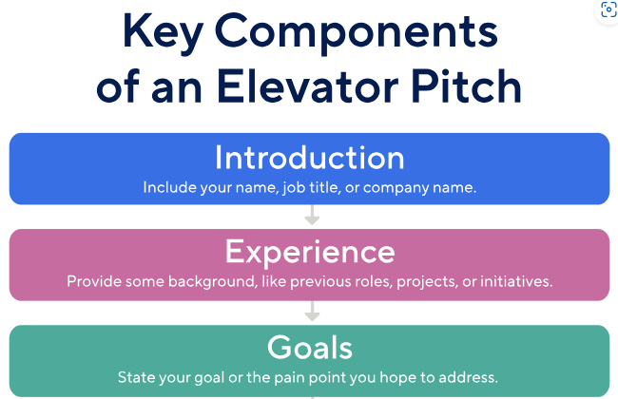
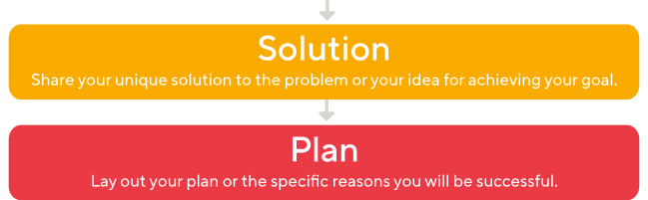

Slide 10
KEY COMPONENTS OF ELEVATOR PITCH
Introduction-This element doesn't need to be fancy or complicated. Make it simple and get straight to the point.
For example, if you're pitching a time management tool, your hook can be a personal story like: "When I first started my business, and so on.
Experience: State any relevant work experience, or give your listener a little background about your company, brand, or idea.

Slide 11
KEY COMPONENTS OF ELEVATOR PITCH
Goals: Clearly state your ultimate goal. This could be a pain point or problem you hope to address or value you can add. Some proof of past success or stats that speak to your success could make it a lot more genuine.
Solution/Proposition: Tell your listener about your unique solution to the problem. Let them know that you're different—that your product or service isn't just another iteration of what came before.
Plan: Explain your plan for achieving your goal. Demonstrate that you have the necessary skills and knowledge, and be specific about how you are better equipped than your competitors to do it.

Slide 12
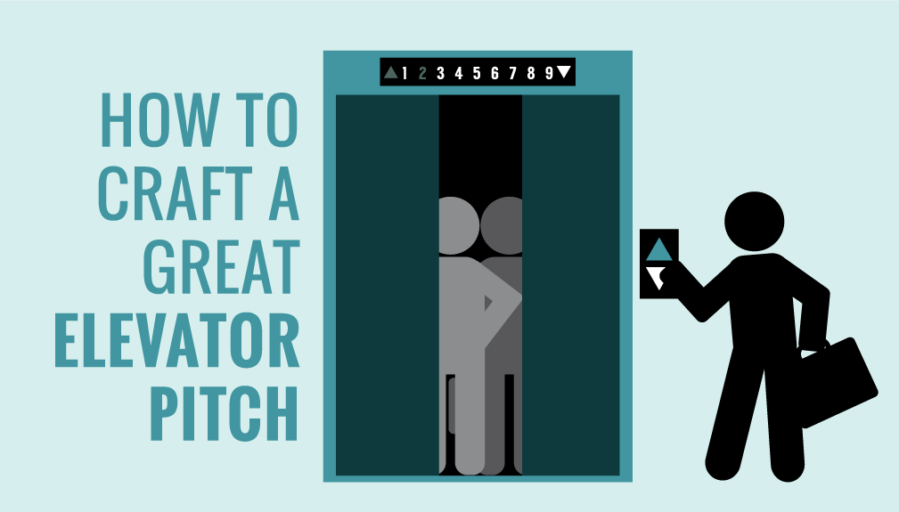
TIPS TO PERFECT YOUR ELEVATOR PITCH
Stick to your outline.
Speak slowly and clearly.
Record your pitch.
Practice, practice, practice!

Slide 13

OUTLINE
Stick to your outline -To prevent getting off-topic, it’s important to stick to your outline at least to some extent.
While you don’t need to recite it word for word, it’s best to memorize the majority of your pitch.

Slide 14
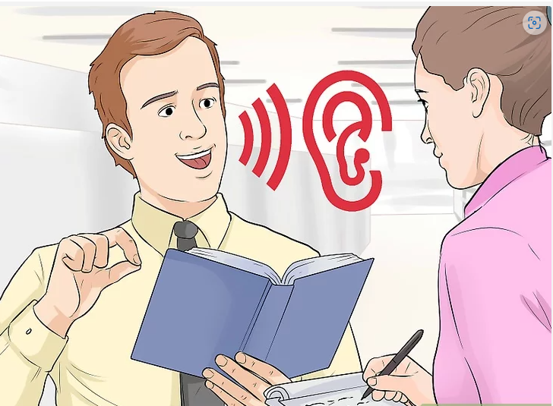
SPEAK SLOWLY AND CLEARLY
Many professionals tend to talk quickly when they’re nervous.
But it’s important to enunciate and speak slowly so the audience can understand you. But try not to slow yourself down too much or you’ll go over your allotted time.

Slide 15

Record your pitch
Record yourself reciting the pitch to work on any areas that need improvement.
Practice your pitch a handful of times by playing the recording back and working out any pain points.
A couple of key areas to focus on are speed and tone. It’s better to sound overly energized rather than monotone.

Slide 16

Practice, practice, practice!
There’s nothing more effective than practicing your pitch until you’re able to recite it in your sleep.
If possible, practice in front of friends and family to get constructive feedback on how you can make your pitch even better.
Even if you have years of experience, you can never go wrong with being overly prepared.

Slide 17
Common elevator pitch mistakes to avoid
Rambling and using too much jargon-One of the biggest mistakes in delivering an elevator pitch is exceeding the optimal amount of time and filling it with industry jargon. Avoid technical terms that might confuse your audience.
Not communicating your value proposition in a compelling way-Your elevator speech should quickly and effectively convey your unique value. This is especially crucial when addressing a potential employer or investors.

Slide 18
Common elevator pitch mistakes to avoid
Not tailoring your pitch to your target audience-A one-size-fits-all approach rarely works for an elevator pitch. Tailor your message to your specific audience.
Forgetting to include a call to action-An effective elevator pitch should end with a clear next step. This gives your audience a concrete way to continue the conversation and build your network.

Slide 19

Blue Sky Thinking
Blue sky thinking is a creative problem-solving technique that encourages individuals to think without constraints or limitations. It's often associated with brainstorming and idea generation, where participants are encouraged to explore unconventional and even seemingly unrealistic ideas.

Slide 20
Steps to Apply Blue Sky Thinking in Presentations:
Suspend Constraints: During brainstorming, don’t worry about practicalities such as budget, time, or feasibility. The aim is to generate ideas without restrictions.
Think Big: Encourage bold, ambitious ideas that challenge the status quo. Ask “what if” questions like, “What if we had unlimited resources?” or “What if we could start from scratch?”
Collaborative Mindset: Invite different perspectives. Often, combining diverse ideas leads to innovative solutions.
Refine & Filter: After generating blue sky ideas, you can later refine them based on feasibility, but during the creative phase, let the ideas flow freely.

Slide 21
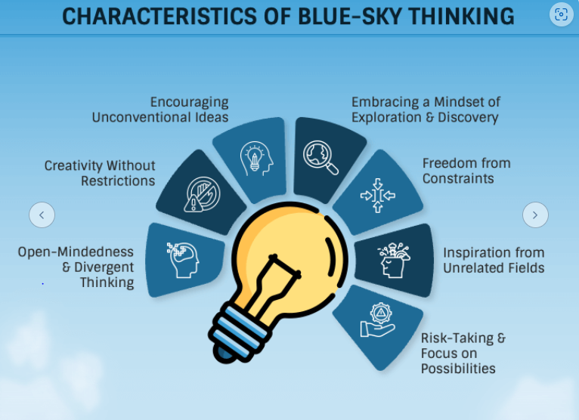

Slide 22
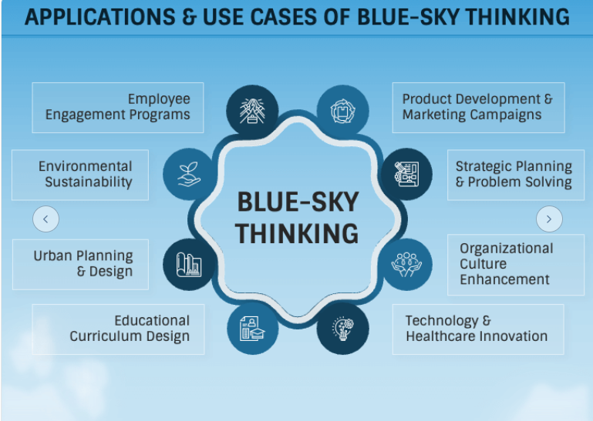

Slide 23
Significance of the Blue Sky Thinking
Encourages Creativity and Innovation-Blue sky thinking allows presenters to step outside of conventional boundaries and explore fresh, creative ideas.
Inspires Engagement and Collaboration-Blue sky ideas often spark curiosity and invite collaboration. When you present big ideas, people are more likely to engage in a discussion, offering their own suggestions or building upon your ideas.

Slide 24
Significance of the Blue Sky Thinking
Promotes Long-Term Vision-Presentations that incorporate blue sky thinking often focus on the bigger picture, beyond immediate problems or short-term goals.
Stimulates Problem Solving-When dealing with complex issues, blue sky thinking in a presentation can encourage out-of-the-box solutions.
Rather than focusing on the constraints, it pushes the audience to explore multiple pathways and think beyond current obstacles.
Builds Confidence and Optimism-When you present ideas that are bold and imaginative, it encourages a sense of optimism and confidence in the possibilities ahead.

Slide 25
Other Thinking Ideas
Red sky thinking represents passionate, bold, and high-energy thinking. It encourages individuals to push boundaries and explore daring, unconventional ideas.
White sky thinking is associated with logical, practical, and fact-based thinking. It focuses on clarity, realism, and structured thought processes.
Purple sky thinking is a blend of creative and imaginative thinking with a touch of sophistication and long-term vision.

Slide 26
THANK YOU

Slide 27
Q&A
What is the primary purpose of the Presentation?
To entertain the audience
To inform, persuade, or inspire the audience
To fill time
To showcase visual Aids
Notes:
b

Slide 28
What does “engaging the audience” mean during a Presentation?
Asking the audience to remain silent
Making the audience participate and connect with the content
Ignoring the audience questions
Talking without pauses
Notes:
b

Slide 29
How can a Presenter leave a lasting impression at the end of a Presentation?
By using a memorable quote or call to action
By quickly ending the presentation
By listing every point again
By thanking the audience repeatedly
Notes:
a

Slide 30
A single session presentation can be for________
An hour
Three hours
Quarter of an hour
Six hours
Notes:
Ans: a

Slide 31
The objective of the presentation “how to coexist with olive ridleys?” to a group of fishermen can be for ____________purpose.
Provocation
Information
Teaching
stimulation
Notes:
Ans: b

Slide 32
The phrase, “ I therefore suggest the following strategy“ – is ideally used at ____________ stage of the presentation
Intro
Main idea of the presentation
Conclusion
none
Notes:
Ans: c

Slide 33
Creative ideas that are not limited by current thinking or beliefs are also known as____
Red sky thinking
Blue sky thinking
White sky thinking
Purple sky thinking
Notes:
Ans: b

Slide 34
Which among the following is appropriate while presenting a topics?
Read from the PPT only
Carry a small chit for clues and keep glancing at the PPT
Show videos alone
none
Notes:
Ans:

Slide 35
Typical length of an elevator pitch?
10 sec
30sec – 1 min
5 min
10min
Notes:
Ans: b

